Slide 1

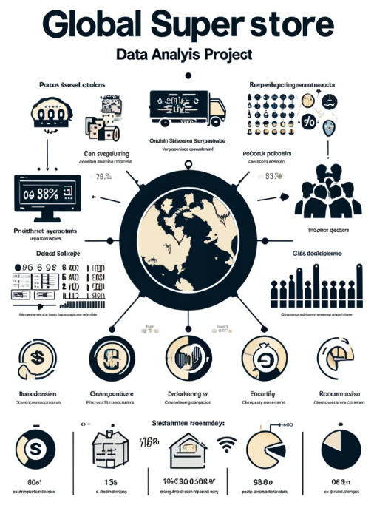


Data Set Story & Purpose
To provide an overview of the sales data analysis for Global Superstore, highlighting the company's product sales, customer profiles, regional performance, and sales trends.
Data Analyst: Fatma Nur Azman

Slide 2
1
OVERVIEW
Data Set Story
Product-Based Analysis
Customer-Based Analysis
Region-Based Analysis
Trend-Based Analysis
General Observations
Summary of Findings
Thank You
Data Analyst: Fatma Nur Azman

Slide 3
2
DATA SET STORY
Global Superstore is a retail company, and our dataset includes information on its sales. The data encompasses product categories, customer segments, regions, countries, and more. The aim is to analyze this data to understand the company's performance and identify potential improvement opportunities.
Data Analyst: Fatma Nur Azman

Slide 4
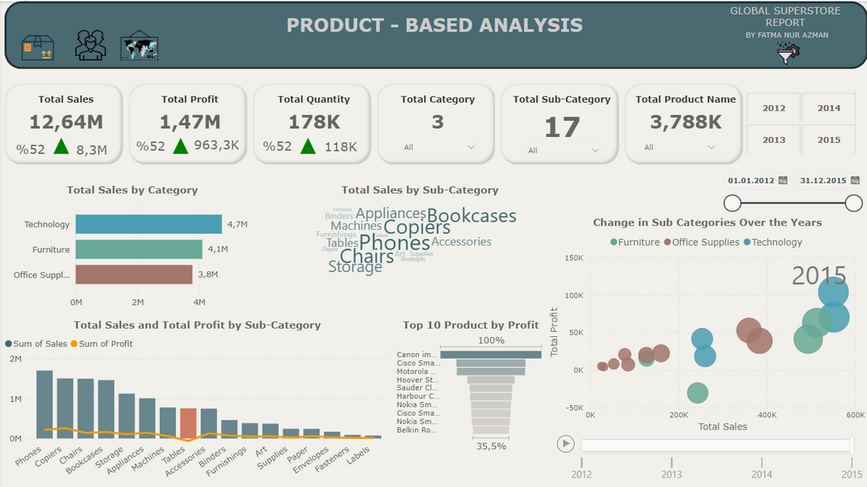
3
PRODUCT-BASED ANALYSIS
Most Profitable Products: The 'Technology' category. %45,2 . It is crucial to prioritize this category and ensure these products are well-stocked.
Low Profitability Categories: The 'Furniture' category. A review of the pricing and marketing strategies for this category is necessary to enhance performance.
Unprofitable Products: The 'Tables' subcategory
It is essential to optimize the product portfolio to address this issue.
Data Analyst: Fatma Nur Azman

Slide 5
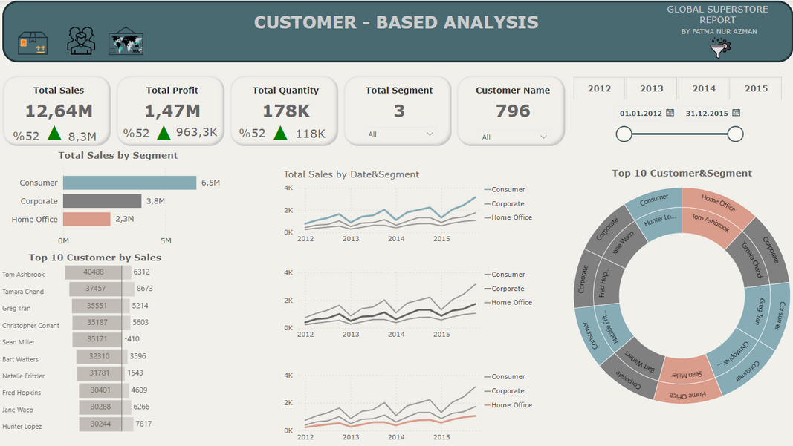
4
CUSTOMER-BASED ANALYSIS
Most Profitable Segment: The 'Consumer' segment. % 51,1 . The 'Consumer' segment is the most profitable and should be the focus for further engagement.
High-Value Customers: High-value customers should be managed with enhanced relationship management strategies.
Underperforming Segment: The 'Home Office' segment. % 18,9 . The 'Home Office' segment underperforms in sales, necessitating new marketing strategies.
Data Analyst: Fatma Nur Azman

Slide 6
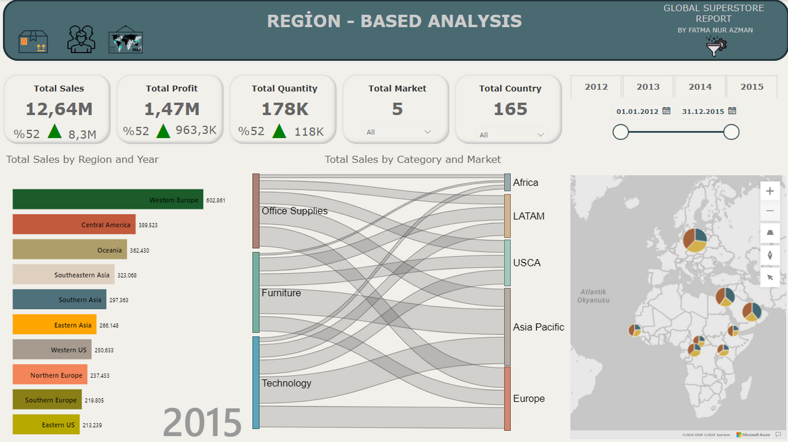
5
REGION-BASED ANALYSIS
Top-Performing Market: The 'Asia Pacific' % 32,0 market 'Asia Pacific' is the top-performing market, indicating potential growth opportunities.
Highest Sales Region: The 'Western Europe' %13,7 region The 'Central' region has the highest sales and should receive more resources and attention.
Lower Sales Region: The 'Central Asia' region
The 'West' region has lower sales compared to others; marketing and sales strategies need review.
Data Analyst: Fatma Nur Azman

Slide 7
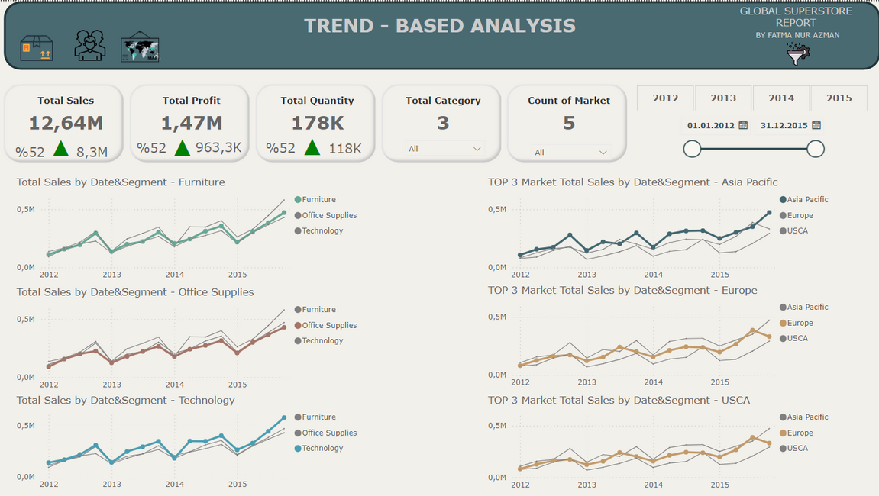
6
TREND-BASED ANALYSIS
Quarterly Trends:
The 'Technology' category shows significant fluctuations, peaking in the second and fourth quarters.
The 'Furniture' category sees high sales in the second and fourth quarters.
'Office Supplies' category maintain steady sales throughout the year, with a slight increase in the fourth quarter.
Data Analyst: Fatma Nur Azman

Slide 8
7
TREND-BASED ANALYSIS
Monthly Trends:
The 'Technology' category sees spikes in sales at the beginning and end of the year.
The 'Furniture' category experiences increased sales in the final months of the year.
'Office Supplies' category have consistent sales, with slight increases in June and December.
Data Analyst: Fatma Nur Azman

Slide 9
8
GENERAL OBSERVATIONS
Sales in 2015 show a general increase, suggesting the need for strategies to maintain growth.
Different product categories exhibit varying seasonal trends, which should be understood and addressed accordingly.
Data Analyst: Fatma Nur Azman

Slide 10
9
SUMMARY OF FINDINGS
Analyzed product performance, customer segmentation, regional sales, and seasonal trends to provide actionable insights.
Recommendations focus on enhancing profitability, customer engagement, and addressing regional and seasonal sales trends.
Data Analyst: Fatma Nur Azman

Slide 11

THANK YOU
Data Analyst: Fatma Nur Azman

